Slide 1

Bangladesh Army University of Engineering & Technology Department of Electrical & Electronic Engineering
Lecture: 04 - 06
Course Code: EEE 1261
Course Title: Electronic Devices and Circuits
Course Teacher: Ferdous Farjana
Designation: Lecturer, Dept. of EEE, BAUET

Slide 2
Outline
What is Diode?
Characteristics of A P-N Junction Diode
Current-Voltage Characteristics of A Diode
Knee Voltage
Breakdown Voltage
PIV
Leakage Current
Diffusion Current
Potential Barrier
Ideal Diode Vs. Practical Diode
Applications of A P-N Junction Diode
Mathematical Problems

Slide 3

What is Diode?
A diode is a semiconductor device that essentially acts as a one-way switch for current.
It allows current to flow easily in one direction but severely restricts current from flowing in the opposite direction.
Diodes are also known as rectifiers because they change AC current into DC current.
Diodes have polarity, determined by an anode (positive lead) and cathode (negative lead).
P
N
Anode
Cathode
Fig. 1: Diode symbol.

Slide 4
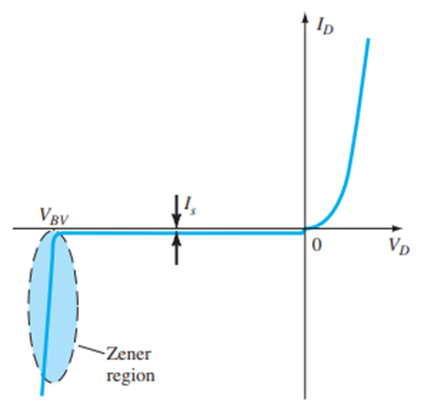
Characteristics of A P-N Junction Diode
Zero Bias: No external voltage potential is applied to the p-n junction diode.
Reverse Bias: The voltage potential is connected negative (-ve) to the p-type material and positive (+ve) to the n-type material across the diode which has the effect of increasing the p-n junction diode’s width.
Forward Bias: The voltage potential is connected positive (+ve) to the p-type material and negative (-ve) to the n-type material across the diode which has the effect of decreasing the p-n junction diode’s width.
Fig. 2: Characteristics of a p-n junction diode.

Slide 5
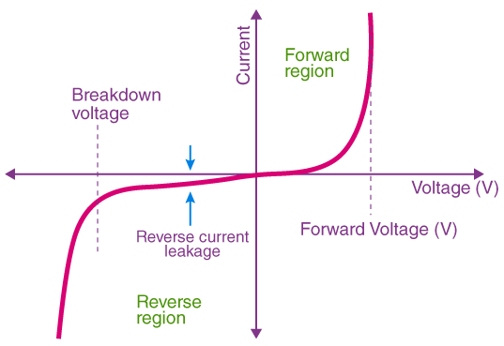
Current-Voltage Characteristics of A Diode
Fig. 3: I-V curve of a diode.

Slide 6
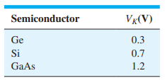
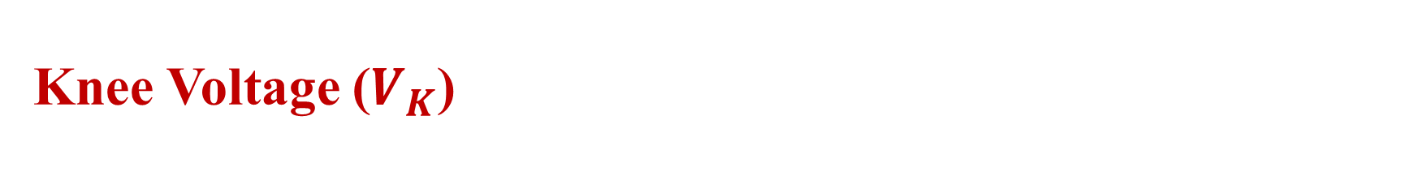

Knee Voltage ($V_{K}$)
In the forward bias, the voltage at which the current starts to increase rapidly is called the knee voltage.
The voltage at which the diode starts its conduction is also called knee voltage.
Fig. 4: Knee voltages ($V_{K}$) of semiconductors.

Slide 7

Breakdown Voltage ($V_{B}$)
In the reverse bias, the voltage at which the current starts to flow and the diode gets damaged is called the breakdown voltage.
It is also known as Zener voltage.

Slide 8
Peak Inverse Voltage (PIV) or Peak Reverse Voltage (PRV)
The maximum reverse bias potential that can be applied before entering the breakdown region is called the peak inverse voltage or peak reverse voltage.

Slide 9

Leakage Current or Reverse Saturation Current ($I_{S}$)
The saturation current is that part of the reverse current in a semiconductor diode caused by the diffusion of minority carriers from the neutral regions to the depletion region.

Slide 10
Diffusion Current
Diffusion current is a current in a semiconductor caused by the diffusion of charge carriers (holes and/or electrons).
Diffusion current exists even though there isn’t an electric field applied to the semiconductor.

Slide 11
Potential Barrier
The electric field between the acceptor and the donor ions is called a barrier.
Potential barrier is the difference of potential from one side of the barrier to the other side.

Slide 12
Ideal Diode Vs. Practical Diode
Ideal Diode: An ideal diode is a diode that acts like a perfect conductor when voltage is applied forward-biased and like a perfect insulator when voltage is applied reverse-biased.
Practical Diode: In a practical diode, there is very little forward current until the barrier voltage is reached. When reverse bias, only a small amount of current flows as long as the reverse voltage is less than the breakdown voltage of the device.

Slide 13
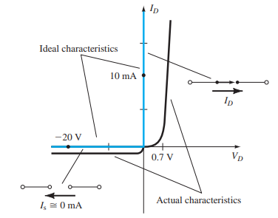
Ideal Diode Vs. Practical Diode
Fig. 5: Ideal diode vs. practical diode curve.

Slide 14
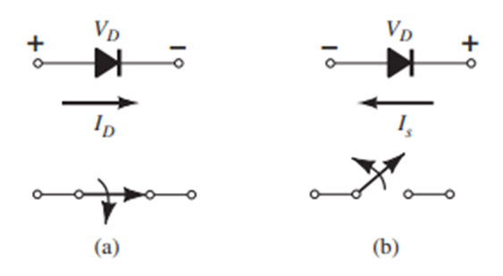
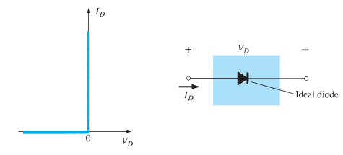
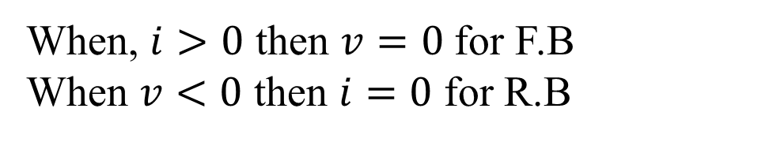
Ideal Diode Vs. Practical Diode
When, $i>0$ then $v=0$ for F.B
When $v<0$ then $i=0$ for R.B
Fig. 6: Volt-Ampere characteristics curve for ideal diode.
Fig. 7: Ideal semiconductor diode: (a) forward-biased; (b) reverse-biased.

Slide 15
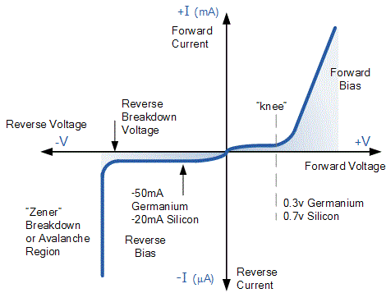
Ideal Diode Vs. Practical Diode
Fig. 8: Volt-Ampere characteristics curve for practical diode.

Slide 16
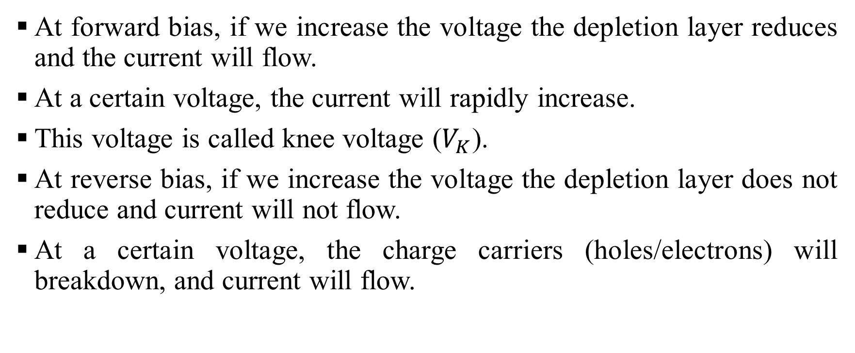
Ideal Diode Vs. Practical Diode
At forward bias, if we increase the voltage the depletion layer reduces and the current will flow.
At a certain voltage, the current will rapidly increase.
This voltage is called knee voltage ($V_{K}$).
At reverse bias, if we increase the voltage the depletion layer does not reduce and current will not flow.
At a certain voltage, the charge carriers (holes/electrons) will breakdown, and current will flow.

Slide 17
Ideal Diode Vs. Practical Diode
This voltage is called the breakdown voltage.
At this voltage, the junction will get damaged by a high amount of current flow.
In reverse bias, a very small amount of current will flow due to the minority carrier which is called saturation current or reverse bias current.
Before entering the breakdown region, the maximum voltage that can be applied to the reverse bias is called peak inverse voltage (PIV).

Slide 18
Applications of A P-N Junction Diode
It is used as a rectifier that converts AC or bidirectional current into DC or unidirectional current.
It is also used as detectors in RF, circuits, LEDs, PIN diodes, RF switches, clippers, etc.
It is used as rectifiers, switching diodes, Zener diodes, varactor diodes (variable resistance), photodiodes, solar cells, Light Emitting Diodes, LASERs, etc.

Slide 19
Mathematical Problems
Will be discussed and solved in the classroom on the whiteboard.
Will be provided with hand-notes.
Will be practiced using books.
Will be shown on the projector screen.

Slide 20
Reference Books
Electronic Devices and Circuit Theory: Robert L. Boylestad.
Microelectronic Circuits: Sedra Smith.
Electronic Devices and Circuits: Millman and Halkias.

Slide 21

THANK YOU

